Slide 1
Capstone Project: Battle of the Neighborhoods
Applied Data Science Specialization by IBM

Slide 2
contents
Introduction Definition of the business problem and the target audience.
Data Description of the data and sources used to solve the problem.
Methodology Discussion of the exploratory data analysis, the inferential statistical testing, and the machine learnings that were used.
Results Presentation of the results.

Slide 3
Objective
Choose the ideal location for the expansion of a New York City based gallery to San Francisco.
Critical factors
Neighborhood safety, accessibility and visibility
Surrounding businesses and possible competitors
Space size and affordability
Comparative analysis of the neighborhoods of the existing and proposed locations

Slide 4
DATA SOURCES
San Francisco Police Department's dataset
San Francisco’s public transportation geodata such as subway and bus stations as well as the MTA's on- and off- street parking census.
Foursquare for the visibility factor that different neighborhoods can provide.
Foursquare for competition analysis.
Foursquare for complimentary venues such as cafes and restaurants.
Real estate agencies and accommodation search engines.

Slide 5
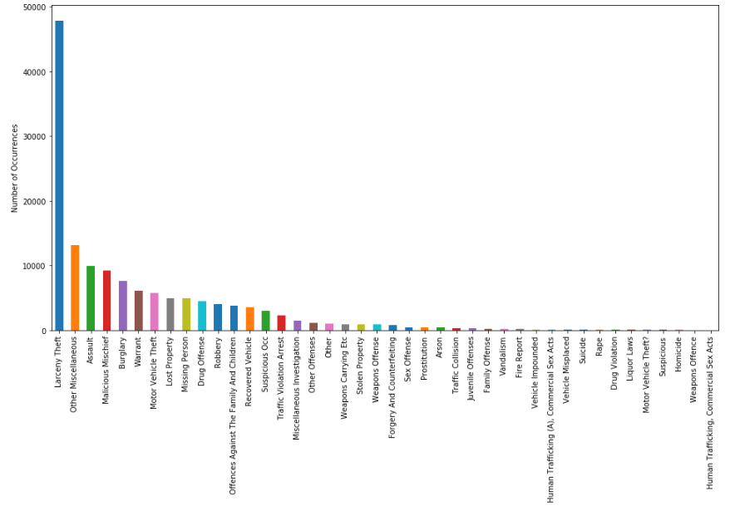
Safety factor analysis

Slide 6
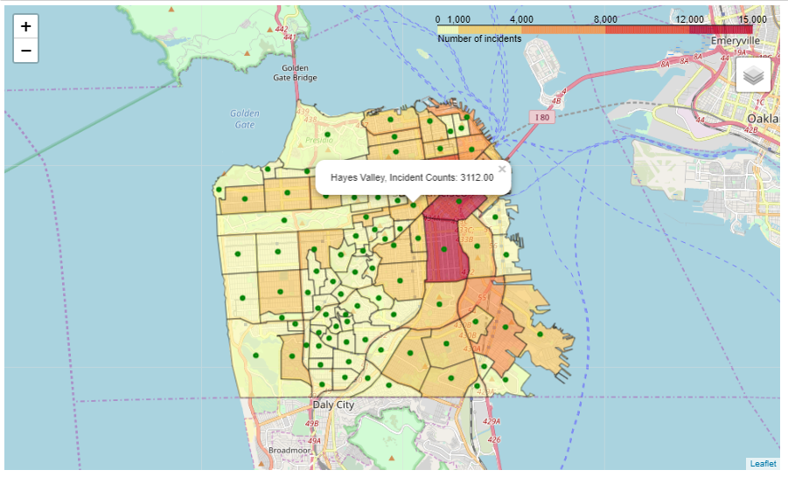
CRIME INCIDENTS CHOREOPLATH MAP

Slide 7
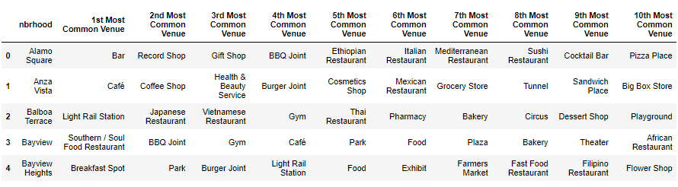
100 Most Popular Venues At A 500m Radius For All San Francisco Neighborhoods

Slide 8
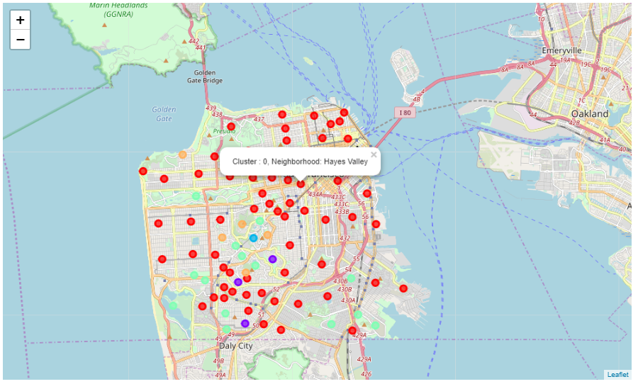
k-means clusters

Slide 9
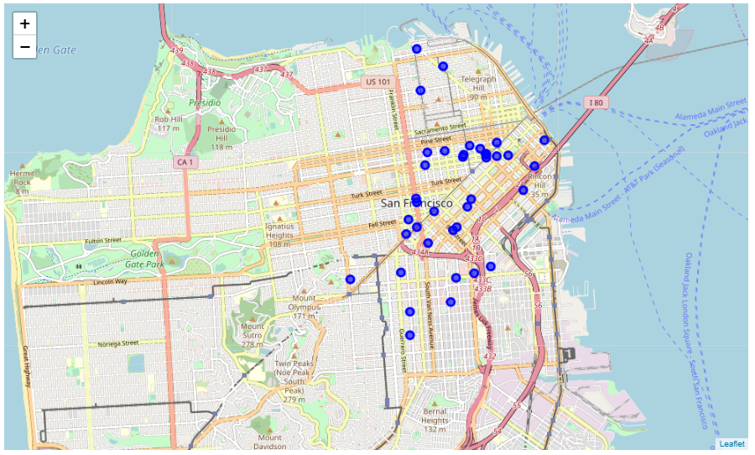
Competitor analysis

Slide 10
RESULTS
Most common crime : Larceny theft
Neighborhoods with the most incidents : South of Market and Inner Mission.
Central Neighborhoods with fewer incidents: Mission Dolores, Hayes Valley and Western Addition
Hayes Value neighborhood: lot of cafes, bars and restaurants
Fell Street:
central & low risk
high neighborhood traffic
low competition
The proposed location for the new gallery would be Fell Street in Hayes Neighborhood.

